Slide 1
Analysis Of Robbery
Aysha Khan
Aditya Patil

Slide 2
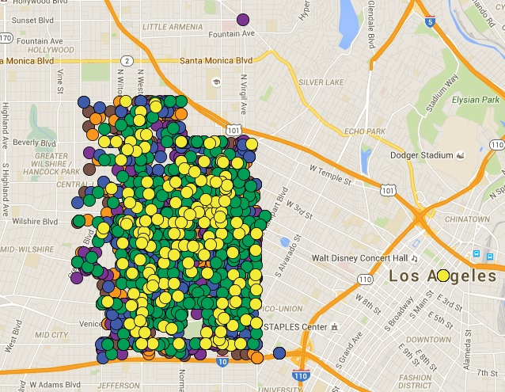
Descriptive Analysis Of Robbery

Slide 3
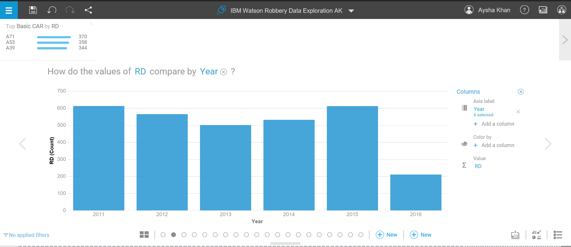
Number of Crimes by reporting districts by year
Maximum number of crimes were occurred in the year of 2011 and 2015.
Over 600 number of crimes were counted in both the years.
Year 2013 counted the minimum number of crimes in last five years.

Slide 4
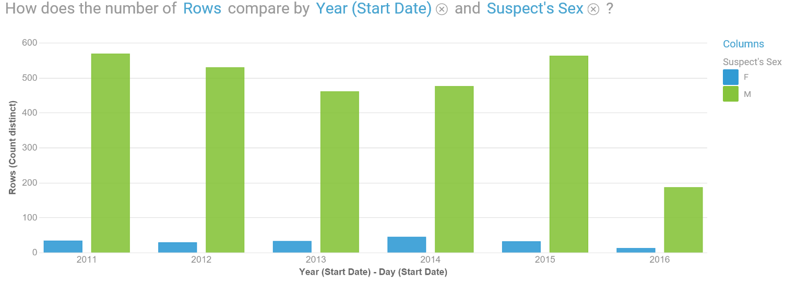
Number of Crimes by male vs female by year
Maximum number of crimes were caused by male suspects.

Slide 5
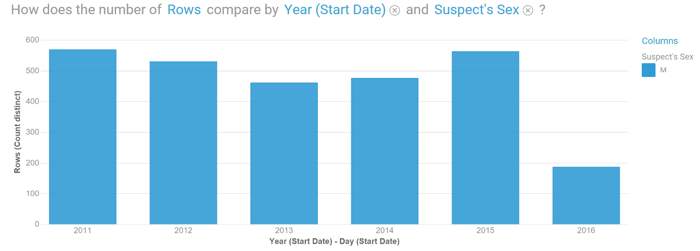

Slide 6
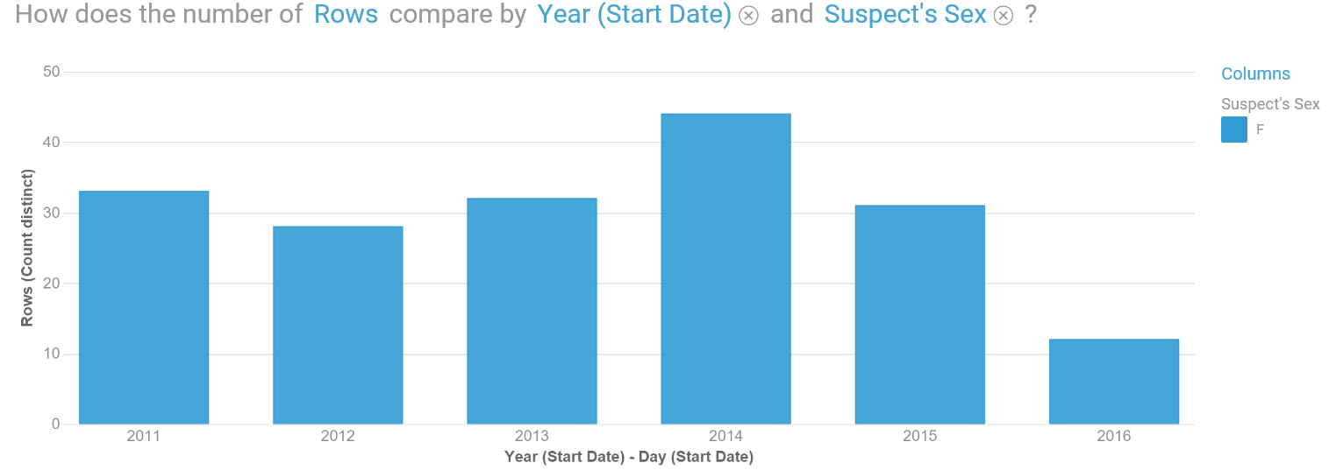

Slide 7
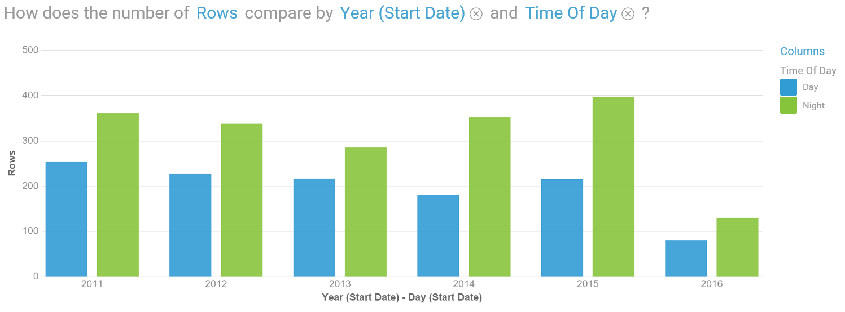
Number of Crimes during the Day vs Night

Slide 8
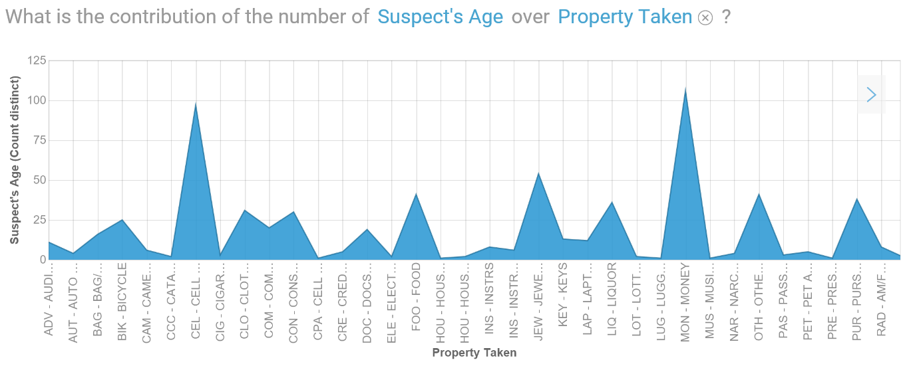
Predictive Analysis Of Robbery
Mostly the property robbed by the suspect is money.
Cell phones are also just as equally robbed as of money by the suspects.

Slide 9
